Slide 1










Be A Manager Ideathon
Empowering women in the textile sector
Funded by the European Union. Views and opinions expressed are however those of the author(s) only and do not Necessarily reflect those of the European Union or the European Education and Culture Executive Agency (EACEA). Neither the European Union nor EACEA can be held responsible for them.

Slide 2













The project is implemented by a consortium of 6 organisations
Funded by the European Union. Views and opinions expressed are however those of the author(s) only and do not Necessarily reflect those of the European Union or the European Education and Culture Executive Agency (EACEA). Neither the European Union nor EACEA can be held responsible for them.

Slide 3


Introduction
Today
The textile sector is one of the most polluting industries
Negative environmental impact
Women account for 70% of textile employment in Europe, but hold less than 25% of management/leadership positions
Funded by the European Union. Views and opinions expressed are however those of the author(s) only and do not Necessarily reflect those of the European Union or the European Education and Culture Executive Agency (EACEA). Neither the European Union nor EACEA can be held responsible for them.

Slide 4

Introduction
W4TEX is a European project that aims to:
Rebalance the representation of women in decision-making positions in the textile sector
Address the problem of the green transition in the textile sector
Work on skills to increase women’s employability
Funded by the European Union. Views and opinions expressed are however those of the author(s) only and do not Necessarily reflect those of the European Union or the European Education and Culture Executive Agency (EACEA). Neither the European Union nor EACEA can be held responsible for them.

Slide 5

Our goal is to equip women with the necessary knowledge and skills in sustainable development and resilience, so they can effectively take on managerial and leadership positions in the textile industry.
Funded by the European Union. Views and opinions expressed are however those of the author(s) only and do not Necessarily reflect those of the European Union or the European Education and Culture Executive Agency (EACEA). Neither the European Union nor EACEA can be held responsible for them.

Slide 6




Project activities
“Be a Manager”
e-learning platform
“WomenThinkGreen”
Toolkit
Ideathons
November 2024
June 2025
December 2025
Funded by the European Union. Views and opinions expressed are however those of the author(s) only and do not Necessarily reflect those of the European Union or the European Education and Culture Executive Agency (EACEA). Neither the European Union nor EACEA can be held responsible for them.
Notes:
6

Slide 7





Ideathon Structure
Team building
Theoretical content
Teamwork
Inspiration success story
Pitch, evaluation, & results
Funded by the European Union. Views and opinions expressed are however those of the author(s) only and do not Necessarily reflect those of the European Union or the European Education and Culture Executive Agency (EACEA). Neither the European Union nor EACEA can be held responsible for them.

Slide 8
Time slot | Description
00:00 – 00:00 | Please add description here
Agenda overview
Funded by the European Union. Views and opinions expressed are however those of the author(s) only and do not Necessarily reflect those of the European Union or the European Education and Culture Executive Agency (EACEA). Neither the European Union nor EACEA can be held responsible for them.

Slide 9


So, who are you?
Let’s play a little game to get to know each other better...
Funded by the European Union. Views and opinions expressed are however those of the author(s) only and do not Necessarily reflect those of the European Union or the European Education and Culture Executive Agency (EACEA). Neither the European Union nor EACEA can be held responsible for them.

Slide 10
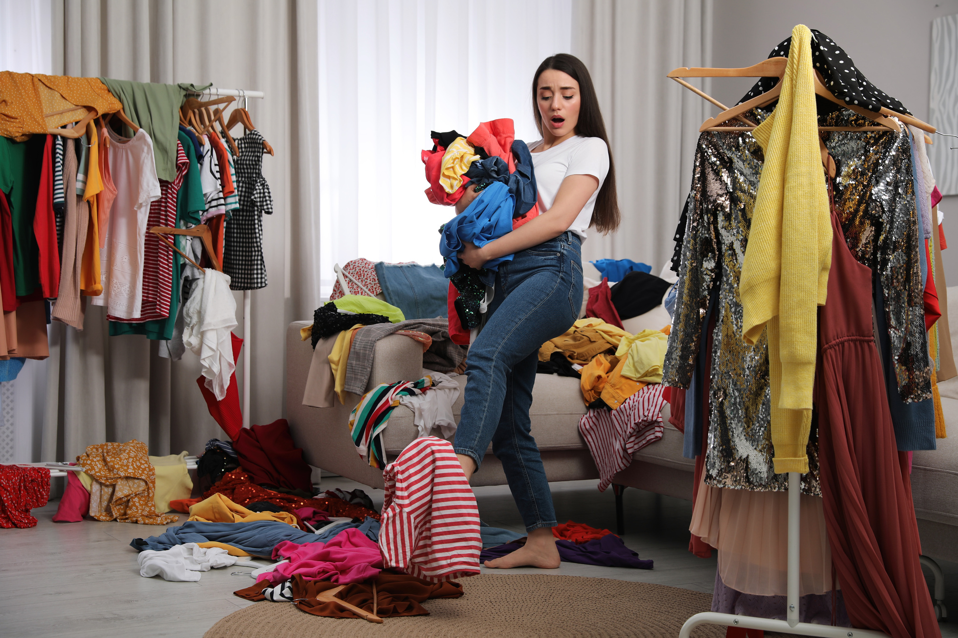
Topic:
Fast Fashion
Funded by the European Union. Views and opinions expressed are however those of the author(s) only and do not Necessarily reflect those of the European Union or the European Education and Culture Executive Agency (EACEA). Neither the European Union nor EACEA can be held responsible for them.
Notes:
10

Slide 11

Fast Fashion
What is fast fashion?
What is your relationship with this model?
What inspires you?
Are there other models?
Funded by the European Union. Views and opinions expressed are however those of the author(s) only and do not Necessarily reflect those of the European Union or the European Education and Culture Executive Agency (EACEA). Neither the European Union nor EACEA can be held responsible for them.

Slide 12
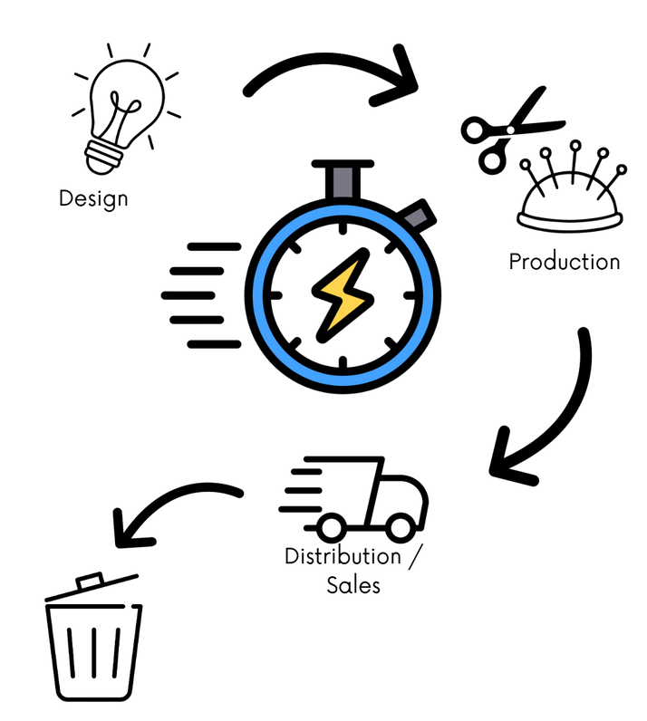
The problematic of fast fashion
Traditional cycle: about 1 year
Fast production cycle: a few weeks
Ultra-fast: 5 to 7 days
Funded by the European Union. Views and opinions expressed are however those of the author(s) only and do not Necessarily reflect those of the European Union or the European Education and Culture Executive Agency (EACEA). Neither the European Union nor EACEA can be held responsible for them.

Slide 13




The problematic of fast fashion
Effects
Waste
1,92 million tons of textil waste generated per year
Oceans
The industry release half a million microfiber tons into the ocean every year
Pollution
From textile using petroleum, during the dyeing, washing and drying processes
Social
Textile workers in Asian countries paid 0.50cts per hour
Funded by the European Union. Views and opinions expressed are however those of the author(s) only and do not Necessarily reflect those of the European Union or the European Education and Culture Executive Agency (EACEA). Neither the European Union nor EACEA can be held responsible for them.

Slide 14

An increasing problem
Fast fashion is a dominant model nowadays
The use of garments decreased by 36%
in 15 years
Funded by the European Union. Views and opinions expressed are however those of the author(s) only and do not Necessarily reflect those of the European Union or the European Education and Culture Executive Agency (EACEA). Neither the European Union nor EACEA can be held responsible for them.

Slide 15



The textile sector today
SCENARIO 1 - FAST FASHION
Born at the end of the twentieth century
Rapid production and rotation of cheap, low-quality clothing
2nd largest consumer of water and responsible for 10% of GHGs worldwide (UN)
Funded by the European Union. Views and opinions expressed are however those of the author(s) only and do not Necessarily reflect those of the European Union or the European Education and Culture Executive Agency (EACEA). Neither the European Union nor EACEA can be held responsible for them.

Slide 16

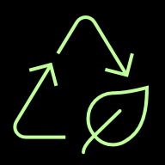

The textile sector today
SCENARIO 1 - FAST FASHION
The number of times a garment is worn has decreased by 36% in the last 15 years
Problematic textile waste disposal: 1.92 million tonnes of waste generated annually
Ultra-fast fashion: 5-7 day manufacturing cycle
Funded by the European Union. Views and opinions expressed are however those of the author(s) only and do not Necessarily reflect those of the European Union or the European Education and Culture Executive Agency (EACEA). Neither the European Union nor EACEA can be held responsible for them.

Slide 17
Breaking the speed
Shift towards slow fashion
Fast fashion remains the dominant business model in the textile sector. While cost-effective, this model is a major contributor to overconsumption, waste, and exploitative labor practices. At the same time, many consumers, especially younger generations, are becoming more aware of sustainability, but are struggling to change their shopping habits. The tension between affordability, fashion trends, and ethics creates a complex landscape for both producers and consumers.
Funded by the European Union. Views and opinions expressed are however those of the author(s) only and do not Necessarily reflect those of the European Union or the European Education and Culture Executive Agency (EACEA). Neither the European Union nor EACEA can be held responsible for them.

Slide 18
Breaking the speed
Shift towards slow fashion
Why it matters
The fast fashion model has huge detrimental social and environmental impacts
Awareness raises and consumers increasingly demand sustainable products. EU legislation is increasing the request for sustainability among companies.
The quality and longevity of garments are key elements of slow fashion.
Funded by the European Union. Views and opinions expressed are however those of the author(s) only and do not Necessarily reflect those of the European Union or the European Education and Culture Executive Agency (EACEA). Neither the European Union nor EACEA can be held responsible for them.
Notes:
Now that we see the problem, let’s talk about why it matters.
First, environmentally, textile waste contributes significantly to pollution and carbon emissions. Synthetic fibers like polyester release microplastics into water and soil. Natural fibers such as cotton demand huge amounts of water and land, thus wasting them means wasting natural resources.
Second, economically, the value of materials lost in discarded clothing is enormous. The European Environment Agency estimates that the EU could save billions of euros each year through effective recycling, repair, and reuse systems. That’s not just about saving the planet. It’s about creating green jobs and new business models.
And finally, socially, much of Europe’s used textiles are exported to Africa and Asia, often under the label of “reuse.” But in reality, many of these items end up in landfills abroad, shifting the environmental burden to other regions. By keeping textile resources in Europe, we can make the system fairer and more transparent.
For SMEs, especially those led by women or rooted in local communities, this transition opens up new opportunities: repair cafés, upcycling workshops, recycling cooperatives, or design labs that make sustainability both creative and profitable.
The message is simple: Textile waste isn’t just an environmental issue, it’s a chance for innovation, empowerment, and leadership in a greener future.
18

Slide 19

Proposed challenges
Education in slow fashion
Design a creative campaign that educates the consumer about the benefits of slow fashion, including factors such as quality, ethics, sustainability, while encouraging more conscious purchasing decisions.
Break the cycle of fast fashion
Propose ideas for new commercial, community, or design models that can curb fast fashion by promoting slower consumption, fair production, and consumer awareness, while remaining engaging and accessible.
Show the true cost of a product
Redesign the product label or shopping experience to clearly and instantly show the true cost of a garment, including its environmental impact, to help customers make informed, value-based purchases.
Working Conditions vs Low Prices
Balancing affordable prices with fair labor practices and environmental responsibility.
Funded by the European Union. Views and opinions expressed are however those of the author(s) only and do not Necessarily reflect those of the European Union or the European Education and Culture Executive Agency (EACEA). Neither the European Union nor EACEA can be held responsible for them.

Slide 20
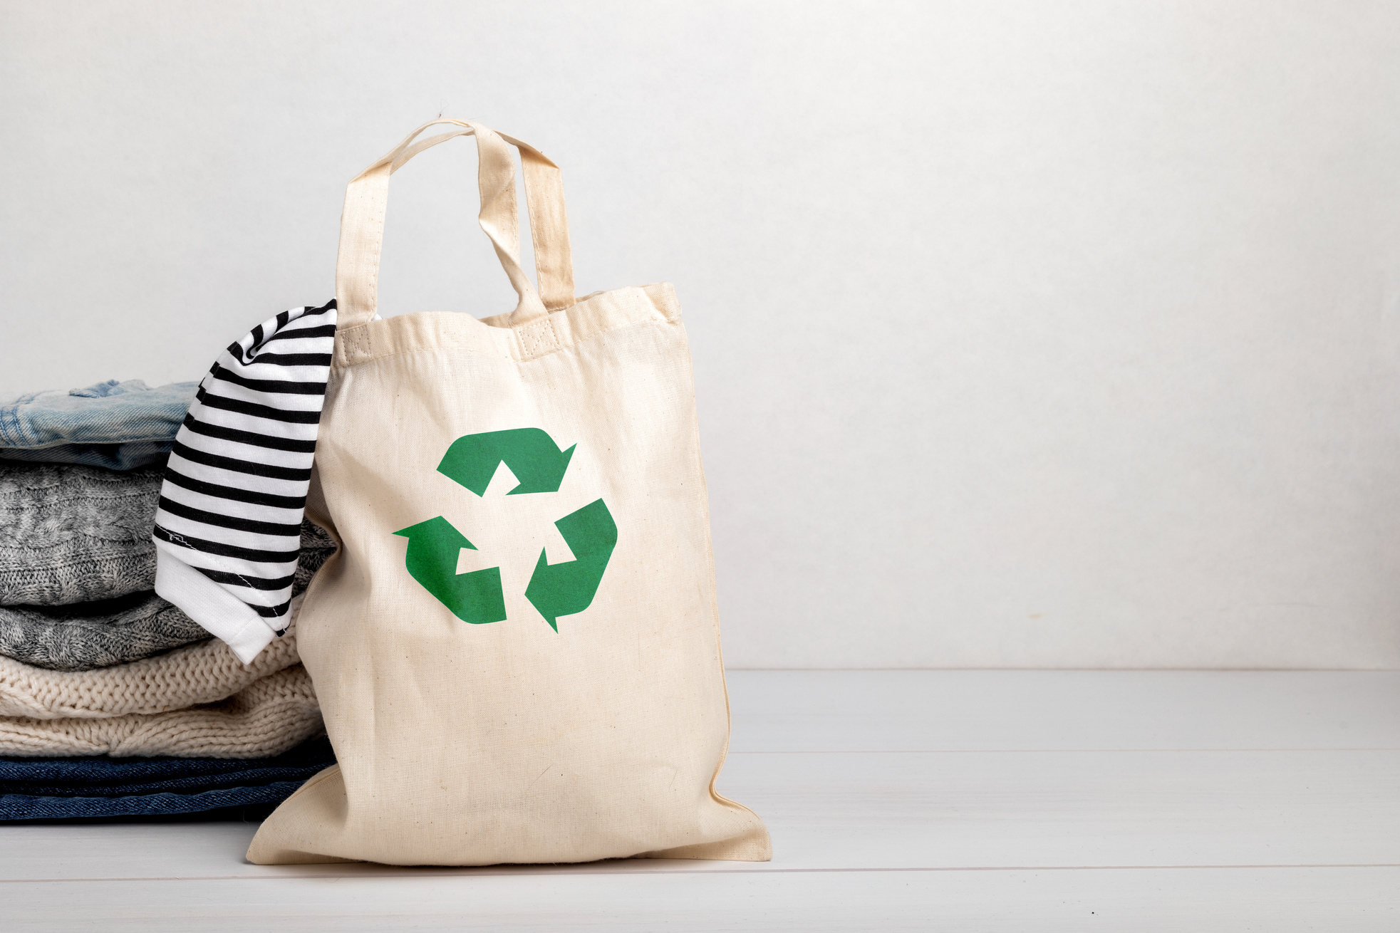
Topic:
Circularity
Funded by the European Union. Views and opinions expressed are however those of the author(s) only and do not Necessarily reflect those of the European Union or the European Education and Culture Executive Agency (EACEA). Neither the European Union nor EACEA can be held responsible for them.
Notes:
20

Slide 21
Circular economy and linear economy
Linear economy
Resource Extraction → Production → Distribution → Consumption → Waste
RECYCLING
PRODUCTION
Circular economy
USE
Funded by the European Union. Views and opinions expressed are however those of the author(s) only and do not Necessarily reflect those of the European Union or the European Education and Culture Executive Agency (EACEA). Neither the European Union nor EACEA can be held responsible for them.
Notes:
22

Slide 22
Circularity in today's Europe
Linear vs Circular Economy in Fashion
Current Model: Linear Economy
Production → Use → Waste
Result:
Constant resource extraction
Massive waste
Pollution
Desired Model: Circular Economy
Make → Use → Reuse → Recycle
Result:
No waste
Resources stay in the loop
Sustainable future
Why it matters? We’re turning a dead-end system into a living cycle.
Funded by the European Union. Views and opinions expressed are however those of the author(s) only and do not Necessarily reflect those of the European Union or the European Education and Culture Executive Agency (EACEA). Neither the European Union nor EACEA can be held responsible for them.

Slide 23
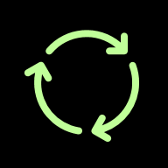


The brutal reality: How circular is the textile sector in Europe?
Global Circularity
Only 0,3% is circular
EU Textile Recycling
Only 1% of textile waste becomes new clothing.
Despite advances, the system is failing to close the loop.
Funded by the European Union. Views and opinions expressed are however those of the author(s) only and do not Necessarily reflect those of the European Union or the European Education and Culture Executive Agency (EACEA). Neither the European Union nor EACEA can be held responsible for them.

Slide 24
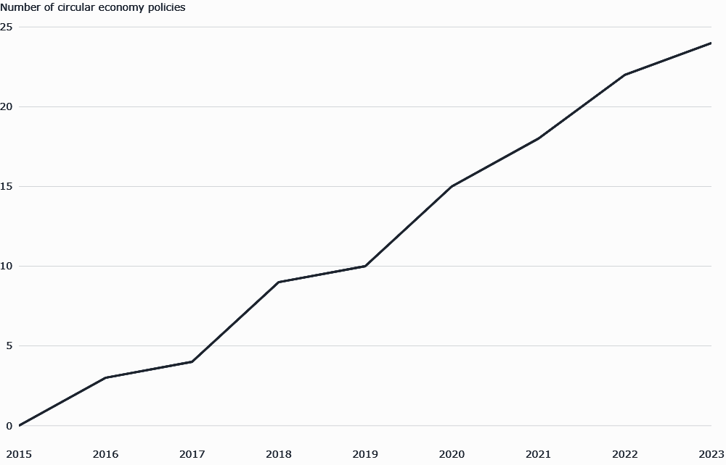
Europe's circular economy
Number of national circular economy policies among the EU Member States adopted from 2015 to 2023
https://url-shortener.me/9LNM
Funded by the European Union. Views and opinions expressed are however those of the author(s) only and do not Necessarily reflect those of the European Union or the European Education and Culture Executive Agency (EACEA). Neither the European Union nor EACEA can be held responsible for them.

Slide 25
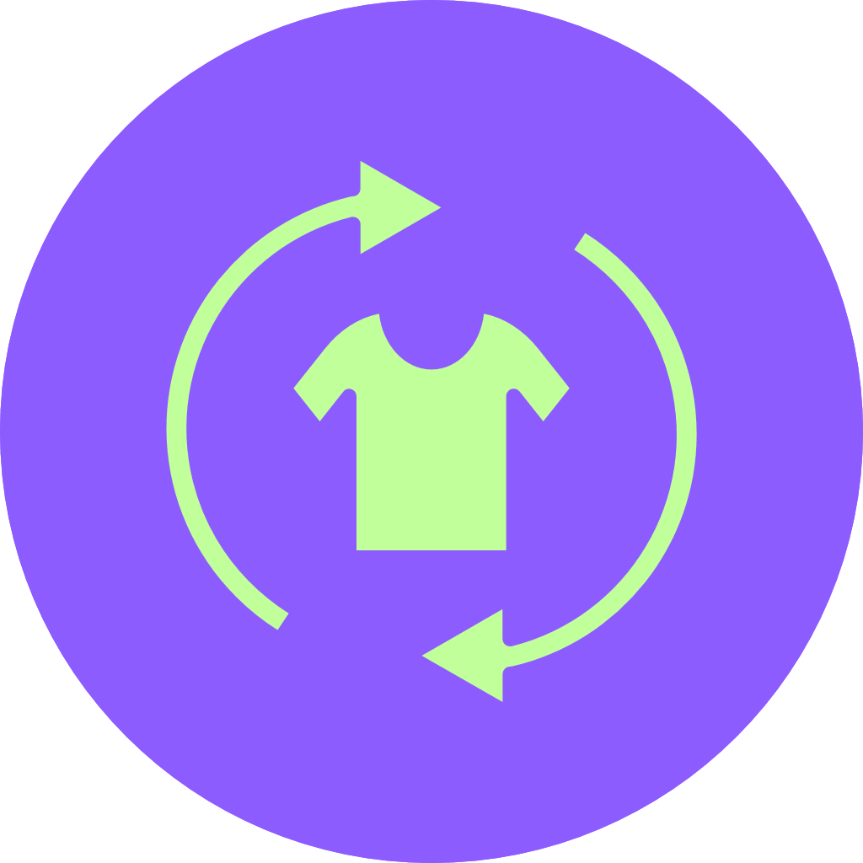


Europe's circular economy:
facts & numbers
With a circularity rate of 11.8% in 2023, Europe consumes a higher proportion of recycled materials than other world regions.
Europe is highly efficient in extracting value from resources, with resource productivity exceeding €2/kg since 2015, more than 2.5 times the world average.
A strong enabling framework of policies, knowledge, and financing has been developed at the EU level to foster and support the circular economy.
Funded by the European Union. Views and opinions expressed are however those of the author(s) only and do not Necessarily reflect those of the European Union or the European Education and Culture Executive Agency (EACEA). Neither the European Union nor EACEA can be held responsible for them.

Slide 26


Europe's circular economy:
high & low-performing countries
30%
1.3%
circularity rate
circularity rate
There is a significant divide between leading countries (e.g., Netherlands, Italy, France, Germany) and those that are transforming towards a circular economy at a slower pace (mainly in Central, Eastern, and Southern Europe).
Funded by the European Union. Views and opinions expressed are however those of the author(s) only and do not Necessarily reflect those of the European Union or the European Education and Culture Executive Agency (EACEA). Neither the European Union nor EACEA can be held responsible for them.

Slide 27

Europe's circular economy:
main plan
Until 2030
THE AMBITION
THE REALITY
Double the share of recycled materials used in the EU's economy.
Challenging progress: Current trajectories indicate the goal is at risk without increased action.
Funded by the European Union. Views and opinions expressed are however those of the author(s) only and do not Necessarily reflect those of the European Union or the European Education and Culture Executive Agency (EACEA). Neither the European Union nor EACEA can be held responsible for them.

Slide 28
Europe's circular economy:
what needs to be done?
Businesses need to adopt more circular models for providing goods and services, helping to lower resource consumption.
Material flows need to become narrower, aiming to reduce the use of virgin materials and recycle the decreasing amount of waste generated.
Consumers should be encouraged to make sustainable product purchases and use products for a long time to help keep their value high.
An enabling framework to promote the approach. This means strong policies need to be in place as well as adequate financing for the transition.
Funded by the European Union. Views and opinions expressed are however those of the author(s) only and do not Necessarily reflect those of the European Union or the European Education and Culture Executive Agency (EACEA). Neither the European Union nor EACEA can be held responsible for them.

Slide 29
Circularity in textiles
What is a circular textile business model?
What are the principles of the circular economy?
How are they applied in the textile sector?
What are the biggest challenges to its implementation?
Funded by the European Union. Views and opinions expressed are however those of the author(s) only and do not Necessarily reflect those of the European Union or the European Education and Culture Executive Agency (EACEA). Neither the European Union nor EACEA can be held responsible for them.

Slide 30
Key Trends Driving Circularity in European Textiles
Key Trends Driving Circularity in European Textiles
THE
REGULATORY SHOCK
THE
TRANSPARENCY DEMAND
EU laws force circularity
(ESPR, DPPs, EPR)
Digital tools + consumer pressure → full supply chain visibility
THE
INFRASTRUCTURE RUSH
THE
CONSUMER
SHIFT
Massive funding builds real recycling systems
Buyers increasingly prioritize environmental and social impact in their purchasing decisions
Funded by the European Union. Views and opinions expressed are however those of the author(s) only and do not Necessarily reflect those of the European Union or the European Education and Culture Executive Agency (EACEA). Neither the European Union nor EACEA can be held responsible for them.

Slide 31
The inevitable outcome:
A system-wide transformation
Given these trends, we can expect one certain future: the linear model will be phased out.
So to be competitive there is a need to become a person who knows how to manage the sustainability shift.
Funded by the European Union. Views and opinions expressed are however those of the author(s) only and do not Necessarily reflect those of the European Union or the European Education and Culture Executive Agency (EACEA). Neither the European Union nor EACEA can be held responsible for them.

Slide 32
Cycle works
Making circularity real
For a small fashion brand, starting a circular system is tough at the beginning: eco-friendly fabrics cost more, getting customers to send back old clothes is complicated, and figuring out how to recycle them is confusing and hard.
However, once brands get past these hurdles, they set up for long-term growth and big advantages in a market that's getting more eco-friendly.
Funded by the European Union. Views and opinions expressed are however those of the author(s) only and do not Necessarily reflect those of the European Union or the European Education and Culture Executive Agency (EACEA). Neither the European Union nor EACEA can be held responsible for them.

Slide 33
Cycle works
Making circularity real
A sustainable fashion brand specializing in organic cotton and hemp clothing is struggling to convince customers to embrace circular economy models. While their garments are designed for durability, many consumers still discard them after a few seasons. The brand wants to introduce a clothing return and resale program but faces logistical challenges, lack of creativity in designing new appealing program.
Funded by the European Union. Views and opinions expressed are however those of the author(s) only and do not Necessarily reflect those of the European Union or the European Education and Culture Executive Agency (EACEA). Neither the European Union nor EACEA can be held responsible for them.

Slide 34
Cycle works
Making circularity real
Why it matters:
It tackles the core challenge of circularity: It moves the focus from just making sustainable products to creating systems that keep them in use.
It tests the business case: Success requires making circularity economically viable and appealing to consumers.
It bridges a critical gap: The industry lacks creative, scalable models to engage customers in circular behaviors, a problem every brand will eventually face.
Funded by the European Union. Views and opinions expressed are however those of the author(s) only and do not Necessarily reflect those of the European Union or the European Education and Culture Executive Agency (EACEA). Neither the European Union nor EACEA can be held responsible for them.

Slide 35
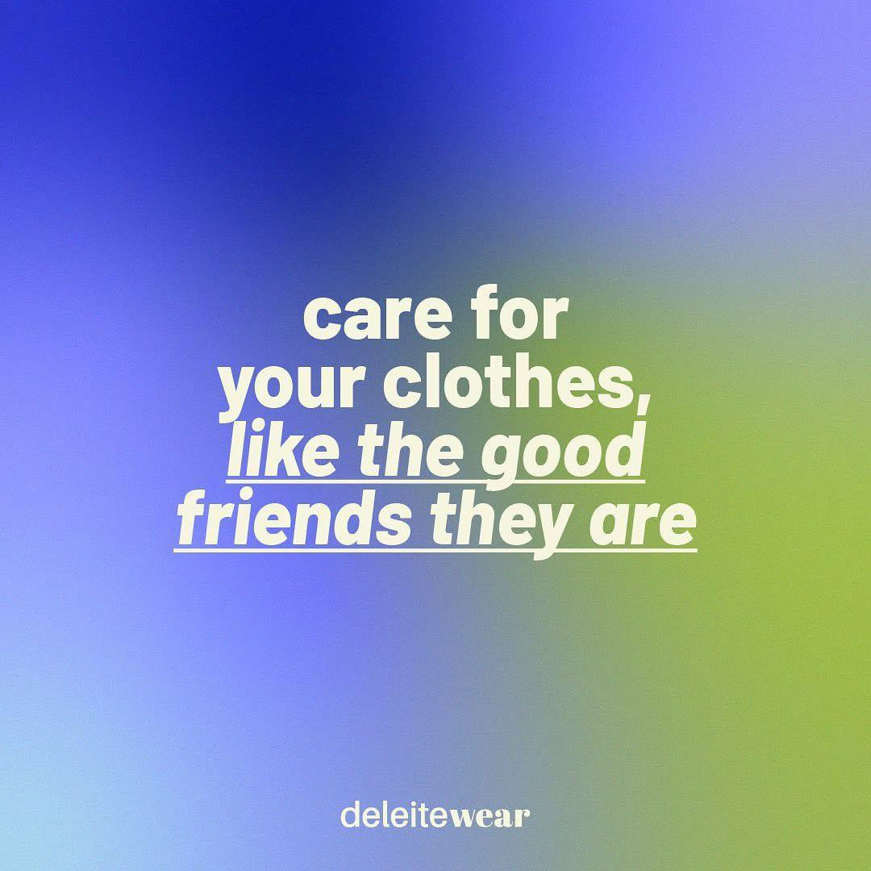
A perfect example of
circular brand
Founded in Valencia, Spain in 2020 by Núria Cava and Laura Fernández Cava, Deleitewear is a sustainable fashion brand that tackles textile waste by upcycling discarded materials, particularly from the hospitality industry, into stylish eco-uniforms and clothing.
The brand partners with social workshops that employ at-risk individuals, promoting social inclusion, and ensures local production in Spain to maintain transparency and reduce its carbon footprint.
Funded by the European Union. Views and opinions expressed are however those of the author(s) only and do not Necessarily reflect those of the European Union or the European Education and Culture Executive Agency (EACEA). Neither the European Union nor EACEA can be held responsible for them.
Notes:
23

Slide 36

Another perfect example of
circular brand
MUD Jeans is a perfect example of a circular brand because they've completely rethought how we use clothing. Instead of just selling jeans, they let customers lease them, ensuring the garments are returned and kept in use.
When jeans wear out, MUD Jeans takes them back to be recycled into new denim, creating a closed loop that drastically reduces waste.
This "borrow-and-return" system makes circular fashion practical and accessible to everyday consumers.
Funded by the European Union. Views and opinions expressed are however those of the author(s) only and do not Necessarily reflect those of the European Union or the European Education and Culture Executive Agency (EACEA). Neither the European Union nor EACEA can be held responsible for them.

Slide 37


The textile sector today
SCENARIO 2 - CIRCULARITY IN THE TEXTILE SECTOR
responsible production
reuse
closed-loop system
Sustainable production systems ⟶ Lower Environmental impact ⟶
Linear production ⟶ produce - consume - throw away
Funded by the European Union. Views and opinions expressed are however those of the author(s) only and do not Necessarily reflect those of the European Union or the European Education and Culture Executive Agency (EACEA). Neither the European Union nor EACEA can be held responsible for them.

Slide 38
The textile sector today
SCENARIO 2 - CIRCULARITY IN THE TEXTILE SECTOR
The circular transition is complex; solutions exist, but a main challenge is the inability of companies to scale
Vertical Scaling
Policy Impact to Make System-Level Changes
Scale-out
Increasing volumes/replicating successful models
Scaling up individual values – social changes
Funded by the European Union. Views and opinions expressed are however those of the author(s) only and do not Necessarily reflect those of the European Union or the European Education and Culture Executive Agency (EACEA). Neither the European Union nor EACEA can be held responsible for them.

Slide 39
Proposed challenges
The real problem: You've set up a take-back program, but less than 10% of customers are using it. The process is inconvenient for them (finding a drop-off, carrying clothes, boxing them up) and the logistics are costing you more in time and money than the value of the returned clothes.
Your mission: Propose a simple, low-cost system that integrates seamlessly into the customer's life to dramatically increase return rates. How can you make returning an old item as easy as ordering a new one?
Also think about clear customer benefits that make returning feel rewarding for them, not just responsible.
Funded by the European Union. Views and opinions expressed are however those of the author(s) only and do not Necessarily reflect those of the European Union or the European Education and Culture Executive Agency (EACEA). Neither the European Union nor EACEA can be held responsible for them.

Slide 40
Proposed challenges
The real problem: You’ve collected hundreds of old garments through your take-back program - but now they’re stacking up in a warehouse. Most are mixed fabrics (cotton-poly blends, elastane, dyes), and textile recyclers refuse them. Turning them into rags feels like giving up, and advanced recycling machines cost millions - far beyond your budget. Your circular system is broken: materials enter, but nothing usable comes out.
Your mission: Build a working, low-cost prototype that turns at least 20 mixed-fabric garments into a sellable, upcycled product. Propose a specific partnership, a new product, or a material innovation that can process this waste stream and keep it in use.
Funded by the European Union. Views and opinions expressed are however those of the author(s) only and do not Necessarily reflect those of the European Union or the European Education and Culture Executive Agency (EACEA). Neither the European Union nor EACEA can be held responsible for them.

Slide 41
Proposed challenges
The real problem: You want to switch from conventional cotton to recycled organic cotton, but the cost is 40% higher. Your customers support sustainability, but are resistant to major price increases. Plus, your supplier won’t sell small test amounts - they demand big minimum orders (MOQ). One wrong move, and you’re stuck with expensive fabric you can’t sell.
Your mission: Design and launch a real, working and creative pre-order campaign that lets you test demand for 50 recycled organic-cotton T-shirts without raising the listed price. Create a way for customers to voluntarily pay more (e.g., “Add a green boost” - choose +20%, +40%, or custom amount). Turn customer support into data strong enough to negotiate a lower MOQ with supplier.
Funded by the European Union. Views and opinions expressed are however those of the author(s) only and do not Necessarily reflect those of the European Union or the European Education and Culture Executive Agency (EACEA). Neither the European Union nor EACEA can be held responsible for them.

Slide 42
Proposed challenges
Towards greater circularity
Select a textile product or service and redesign it to make circularity practical and desirable, ensuring that materials stay in use longer, recover easily, and generate economic and social benefits.
Closing the circle
Create an economically viable circular system to reintroduce used textiles into retail (resale) or production.
Collaboration for circularity
Create a proposal for collaboration between companies to scale circularity without financial losses or losing their competitive advantage, connect and cross borders to achieve a circular system.
Ethical consumption
Create a circular fashion model or campaign that changes consumer behavior towards renting, repairing, reusing, or sharing clothes, making sustainable fashion as attractive as fast fashion.
Funded by the European Union. Views and opinions expressed are however those of the author(s) only and do not Necessarily reflect those of the European Union or the European Education and Culture Executive Agency (EACEA). Neither the European Union nor EACEA can be held responsible for them.

Slide 43
Proposed challenges
The company needs to develop a strategy to encourage customers to return used clothing and make the resale process efficient and profitable. The learners must design a practical and engaging business model for a take-back and resale system.
Re-imagine the resale platform itself. How can we use storytelling, marketing instruments, or something else to create a unique value proposition that attracts both sellers and buyers?
Own challenge?
Funded by the European Union. Views and opinions expressed are however those of the author(s) only and do not Necessarily reflect those of the European Union or the European Education and Culture Executive Agency (EACEA). Neither the European Union nor EACEA can be held responsible for them.
Notes:
This challenge is about leadership, creativity, and empowerment, rather than just about managing textile waste.
Across Europe, we’re producing about 16 kilograms of textile waste per person every year, and less than 1% of it ever becomes new clothing again. Behind these statistics lies a powerful opportunity — especially for women.
In many textile regions, women are the backbone of production but rarely the decision-makers. Through this ideathon, we invite you to step into that leadership role and think, design, and pitch as innovators who can reshape the sector.
42

Slide 44
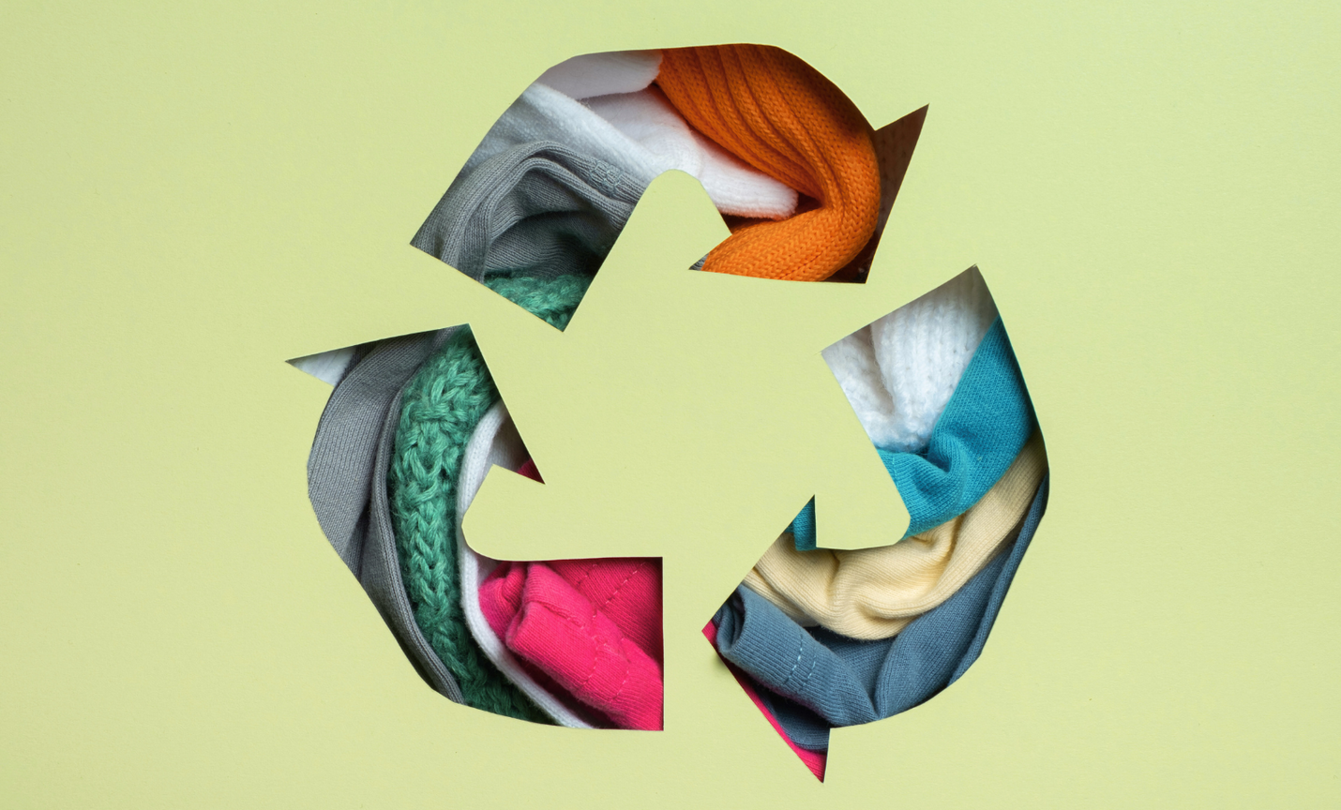
Topic:
Textile recycling & waste
Funded by the European Union. Views and opinions expressed are however those of the author(s) only and do not Necessarily reflect those of the European Union or the European Education and Culture Executive Agency (EACEA). Neither the European Union nor EACEA can be held responsible for them.
Notes:
44

Slide 45
Textile waste and recycling
What is textile waste?
Do you have any idea of the amount of waste generated by the fashion industry every year?
What can be done with this waste?
What is actually done with this waste?
Funded by the European Union. Views and opinions expressed are however those of the author(s) only and do not Necessarily reflect those of the European Union or the European Education and Culture Executive Agency (EACEA). Neither the European Union nor EACEA can be held responsible for them.

Slide 46

Textile recycling & waste in today’s Europe
A sector in transformation: Textile waste
~ 16 kg
4.4 kg
< 1%
textile waste per EU citizen per year​
collected textile for reuse or recycling
used textiles recycled into new garments
Funded by the European Union. Views and opinions expressed are however those of the author(s) only and do not Necessarily reflect those of the European Union or the European Education and Culture Executive Agency (EACEA). Neither the European Union nor EACEA can be held responsible for them.
Notes:
Europe’s textile sector is facing a critical waste problem. The majority of textiles produced each year still end up burned or landfilled, while EU exports of used textiles increased threefold since 2000, mainly to Africa & Asia (EEA, 2025). Even though awareness is growing, collection systems are underdeveloped, and most recycling is still “open loop.” The EU’s new waste and circularity policies aim to reverse this by making textiles durable, repairable and recyclable by design.
Each EU citizen generates ~16 kg of textile waste per year (EEA, 2024).
Only 4.4 kg per person is collected separately for reuse or recycling — the rest ends up in mixed waste.
Less than 1 % of used textiles are recycled into new garments (“fiber-to-fiber” recycling).
46

Slide 47
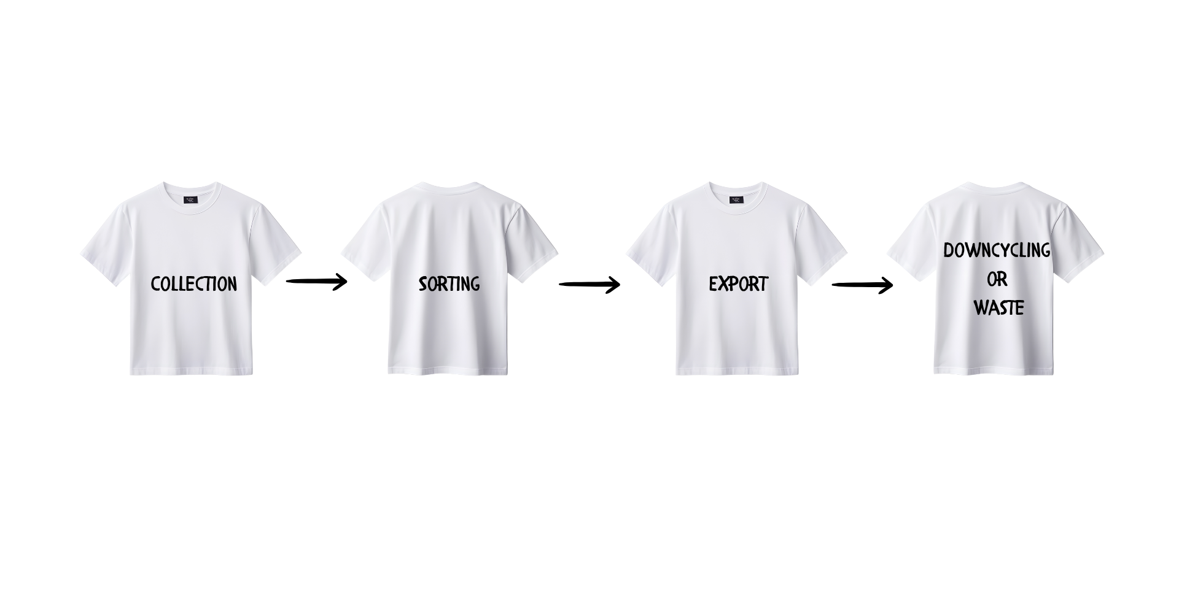
Textile recycling & waste in today’s Europe
A sector in transformation: Structural barriers to a circular textile economy
Complex materials
Limited sorting & recycling infrastructure
Low economic incentive
Unclear end-of-life pathways
Funded by the European Union. Views and opinions expressed are however those of the author(s) only and do not Necessarily reflect those of the European Union or the European Education and Culture Executive Agency (EACEA). Neither the European Union nor EACEA can be held responsible for them.
Notes:
Fiber blending and the lack of design-for-recycling make mechanical or chemical recycling complex. Current technologies can process single fibers, but mixed fabrics remain a major barrier. Finally, policy, innovation and consumer behavior must evolve together to make textile recycling viable.
Complex materials: Most garments mix cotton, polyester, or elastane are hard to separate.
Limited sorting & recycling infrastructure: Few large-scale plants exist across EU Member States.
Low economic incentive: Virgin materials often cheaper than recycled ones.
Unclear end-of-life pathways: Many exported used textiles are dumped or incinerated abroad.
47

Slide 48
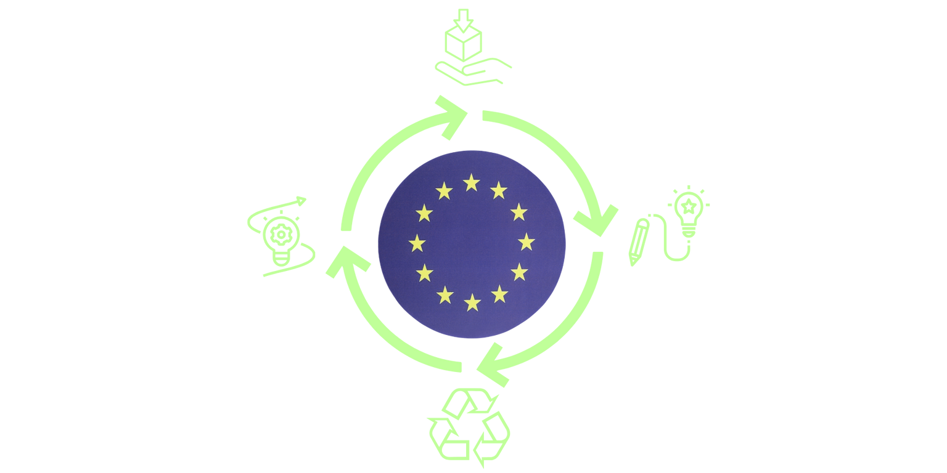
Textile recycling & waste in today’s Europe
A sector in transformation: From waste to resource – The EU’s circular textile vision
EU Strategy for Sustainable and Circular Textiles (2022)
Mandatory separate collection of textiles by 2025
Extended Producer Responsibility (EPR)
Innovation focus
Funded by the European Union. Views and opinions expressed are however those of the author(s) only and do not Necessarily reflect those of the European Union or the European Education and Culture Executive Agency (EACEA). Neither the European Union nor EACEA can be held responsible for them.
Notes:
The EU is entering a decisive phase. The new legislation will reshape how textiles are designed, sold, and recovered, which means a space for innovation: new services for collection, digital traceability tools, design labs, or awareness campaigns that make recycling easy and valuable.
EU Strategy for Sustainable and Circular Textiles (2022): All textiles on the EU market to be recyclable, repairable, and largely made of recycled fibers by 2030.
Mandatory separate collection of textiles by 2025 in all Member States.
Extended Producer Responsibility (EPR): Brands will finance collection, sorting & recycling.
Innovation focus: New sorting technologies, digital product passports, and design-for-circularity training.
48

Slide 49
The textile sector today
SCENARIO 3 – TEXTILE WASTE AND RECYCLING
Textile waste damages the environment by polluting the land, water, and air. Discarded clothing takes years to decompose, releasing toxins into the soil. Microplastics and toxic chemicals further pollute ecosystems.
In Europe: an average of 16 kg of textile waste per year per person, of which 4.4 kg is collected separately for reuse and recycling
challenge of the Harvest
The current level of recycled textiles that are used to produce new clothing is still roughly only 1%
challenge of Demand
Textile-to-textile recycling techniques: mechanical recycling and chemical recycling, thermomechanical and thermochemical recycling
technological challenges
Funded by the European Union. Views and opinions expressed are however those of the author(s) only and do not Necessarily reflect those of the European Union or the European Education and Culture Executive Agency (EACEA). Neither the European Union nor EACEA can be held responsible for them.

Slide 50
Textile recycling & waste
Turning waste into worth
Each year, millions of tonnes of textiles are discarded across Europe, with most ending up in landfills or being incinerated.
SMEs struggle with post-consumer waste, limited recycling access, and few incentives for reuse.
New opportunities are emerging through textile-to-textile recycling, creative upcycling, and industrial symbiosis between fashion, manufacturing, and waste sectors.
Funded by the European Union. Views and opinions expressed are however those of the author(s) only and do not Necessarily reflect those of the European Union or the European Education and Culture Executive Agency (EACEA). Neither the European Union nor EACEA can be held responsible for them.
Notes:
Let’s begin by understanding the scale of the problem.
Across Europe, each citizen throws away around 16 kilograms of textiles every year, but only a small portion (roughly 4 kilograms) is collected separately for reuse or recycling. The rest is simply treated as mixed waste, often ending up in landfills or incineration plants.
Additionally, less than 1% of all discarded textiles are recycled into new textile fibers, which is what we call fiber-to-fiber recycling. That means almost every T-shirt, dress, or pair of jeans we discard is lost from the production loop forever.
Behind these numbers lies a system still built on linear consumption: producing, buying, using, and throwing away at a rapid pace. This pattern is driven by fast fashion and the constant demand for cheap, new clothes.
But change is underway. The EU has declared textiles a priority sector in the shift to a circular economy. By 2025, all Member States must establish separate textile collection systems, and brands will soon be responsible for the waste they generate through Extended Producer Responsibility (EPR) schemes.
As participants in this ideathon, you’re stepping into a moment where policy meets innovation, which is a chance to design solutions that turn waste into value and make the circular transition possible.
50

Slide 51
Textile recycling & waste
Turning waste into worth
Why it matters
Textile waste is one of the fastest-growing waste streams in the EU.
Recycling innovation can create local green jobs, new business models, and ethical value chains.
The EU’s upcoming mandatory collection (2025) and Extended Producer Responsibility (EPR) make waste reduction an urgent priority.
Funded by the European Union. Views and opinions expressed are however those of the author(s) only and do not Necessarily reflect those of the European Union or the European Education and Culture Executive Agency (EACEA). Neither the European Union nor EACEA can be held responsible for them.
Notes:
Now that we see the problem, let’s talk about why it matters.
First, environmentally, textile waste contributes significantly to pollution and carbon emissions. Synthetic fibers like polyester release microplastics into water and soil. Natural fibers such as cotton demand huge amounts of water and land, thus wasting them means wasting natural resources.
Second, economically, the value of materials lost in discarded clothing is enormous. The European Environment Agency estimates that the EU could save billions of euros each year through effective recycling, repair, and reuse systems. That’s not just about saving the planet. It’s about creating green jobs and new business models.
And finally, socially, much of Europe’s used textiles are exported to Africa and Asia, often under the label of “reuse.” But in reality, many of these items end up in landfills abroad, shifting the environmental burden to other regions. By keeping textile resources in Europe, we can make the system fairer and more transparent.
For SMEs, especially those led by women or rooted in local communities, this transition opens up new opportunities: repair cafés, upcycling workshops, recycling cooperatives, or design labs that make sustainability both creative and profitable.
The message is simple: Textile waste isn’t just an environmental issue, it’s a chance for innovation, empowerment, and leadership in a greener future.
51

Slide 52
Proposed challenges
Key facts & figures
♻️ Each European citizen generates ≈16 kg of textile waste/year WHILE only 4.4 kg is collected for reuse or recycling
🔁 Less than 1% of used textiles become new garments
🚛 Over 1.3 million tonnes of used textiles are exported annually AND many end up as waste abroad.
Funded by the European Union. Views and opinions expressed are however those of the author(s) only and do not Necessarily reflect those of the European Union or the European Education and Culture Executive Agency (EACEA). Neither the European Union nor EACEA can be held responsible for them.
Notes:
This challenge is about leadership, creativity, and empowerment, rather than just about managing textile waste.
Across Europe, we’re producing about 16 kilograms of textile waste per person every year, and less than 1% of it ever becomes new clothing again. Behind these statistics lies a powerful opportunity — especially for women.
In many textile regions, women are the backbone of production but rarely the decision-makers. Through this ideathon, we invite you to step into that leadership role and think, design, and pitch as innovators who can reshape the sector.
52

Slide 53

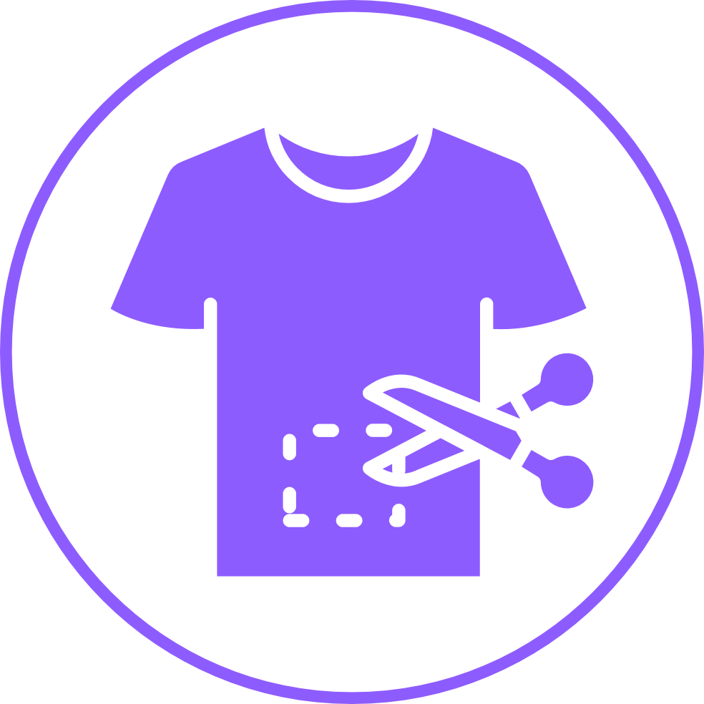

Proposed challenges
Discussion
What ideas could empower women to lead the shift toward textile recycling and reuse?
How can teamwork and creativity help redesign the life of a garment?
Which local partnerships (companies, municipalities, NGOs) could turn waste into opportunity?
Funded by the European Union. Views and opinions expressed are however those of the author(s) only and do not Necessarily reflect those of the European Union or the European Education and Culture Executive Agency (EACEA). Neither the European Union nor EACEA can be held responsible for them.
Notes:
This challenge is about leadership, creativity, and empowerment, rather than just about managing textile waste.
Across Europe, we’re producing about 16 kilograms of textile waste per person every year, and less than 1% of it ever becomes new clothing again. Behind these statistics lies a powerful opportunity — especially for women.
In many textile regions, women are the backbone of production but rarely the decision-makers. Through this ideathon, we invite you to step into that leadership role and think, design, and pitch as innovators who can reshape the sector.
52

Slide 54



Proposed challenges
Challenges to be addressed
Environmental
Social
Economic
High carbon and water footprint; loss of materials and microplastic pollution
Exported waste creates unfair environmental burdens on low-income countries
SMEs lack infrastructure, incentives, and cost-effective recycling technologies
Funded by the European Union. Views and opinions expressed are however those of the author(s) only and do not Necessarily reflect those of the European Union or the European Education and Culture Executive Agency (EACEA). Neither the European Union nor EACEA can be held responsible for them.
Notes:
This challenge is about leadership, creativity, and empowerment, rather than just about managing textile waste.
Across Europe, we’re producing about 16 kilograms of textile waste per person every year, and less than 1% of it ever becomes new clothing again. Behind these statistics lies a powerful opportunity — especially for women.
In many textile regions, women are the backbone of production but rarely the decision-makers. Through this ideathon, we invite you to step into that leadership role and think, design, and pitch as innovators who can reshape the sector.
52

Slide 55
Proposed challenges
Using instead of wasting resources in the value chain
Develop a strategy to minimize unused resources across a product's value chain and turn surplus materials and underutilized resources into new business opportunities to provide sustainable value.
Redesign with waste
Propose ideas to design innovative solutions for the collection, sorting and recycling of textile waste that generate value for both companies and communities, while reducing the environmental footprint.
Collecting textile waste
Create a proposal for collaboration between consumers, recycling plants and textile companies that facilitates the collection of used garments, their recycling and subsequent reuse in new garments.
Wastewater
Develop ideas on how dyeing water could be reduced and what to do with this wastewater from dyeing processes.
Funded by the European Union. Views and opinions expressed are however those of the author(s) only and do not Necessarily reflect those of the European Union or the European Education and Culture Executive Agency (EACEA). Neither the European Union nor EACEA can be held responsible for them.

Slide 56
Time for choosing your challenge!
You are a textile fashion SME, with a small design and distribution department at a national level. You are eager to take another step in the green transition of your business, either by working on one of your products or in collaboration with your value chain.
You can choose one of the proposed challenges... or another of your choice related to the three topics addressed.
Funded by the European Union. Views and opinions expressed are however those of the author(s) only and do not Necessarily reflect those of the European Union or the European Education and Culture Executive Agency (EACEA). Neither the European Union nor EACEA can be held responsible for them.

Slide 57



Teamwork instructions
Team formation
Teams of 3–5 participants
Team name selection
Roles
e.g., Coordinator, Researcher, Designer/Creative, Pitch Presenter, Timekeeper
Funded by the European Union. Views and opinions expressed are however those of the author(s) only and do not Necessarily reflect those of the European Union or the European Education and Culture Executive Agency (EACEA). Neither the European Union nor EACEA can be held responsible for them.
Notes:
Now that we’ve explored the challenge, it’s time to form your teams and start the creative process.
Each team should have three to five members. Try to mix different strengths, maybe one of you is analytical, another is artistic, another confident in public speaking. Diversity will make your ideas stronger and more complete.
Take a few minutes to choose a team name that represents your shared purpose or idea or vision. You can be creative here, as this name will follow you throughout the ideathon.
Then, assign simple roles within your team:
A Coordinator who keeps the group organized.
A Researcher who checks data or examples.
A Creative/Designer who visualizes the idea.
A Pitch Presenter who will deliver the final 3-minute pitch.
A Timekeeper to ensure you stay on schedule.
55

Slide 58
Skills needed for Ideathon and to be a manager in the textile sector
What will we need to put into practice?
Funded by the European Union. Views and opinions expressed are however those of the author(s) only and do not Necessarily reflect those of the European Union or the European Education and Culture Executive Agency (EACEA). Neither the European Union nor EACEA can be held responsible for them.

Slide 59

General management techniques
Structuring your work
Maximize efficiency and productivity, taking into account the human factor within the organization (in this case, your team) and the type of exercise.
Funded by the European Union. Views and opinions expressed are however those of the author(s) only and do not Necessarily reflect those of the European Union or the European Education and Culture Executive Agency (EACEA). Neither the European Union nor EACEA can be held responsible for them.

Slide 60


Planning & Organization
Strategic planning to set clear objectives and define the common vision for the team towards the future.
Organization to focus on the efficient execution of previously made plans, encompassing time management, prioritization of tasks, etc.
Funded by the European Union. Views and opinions expressed are however those of the author(s) only and do not Necessarily reflect those of the European Union or the European Education and Culture Executive Agency (EACEA). Neither the European Union nor EACEA can be held responsible for them.

Slide 61

Problem solving
It requires analytical, critical thinking & creativity.
IDEAL: Identify the problem, define the problem, explore solutions, act, and learn.
Funded by the European Union. Views and opinions expressed are however those of the author(s) only and do not Necessarily reflect those of the European Union or the European Education and Culture Executive Agency (EACEA). Neither the European Union nor EACEA can be held responsible for them.

Slide 62

Decision-making
The decision-making process is a set of steps taken by managers or leaders of a company to select from a variety of alternatives in a given situation.
Funded by the European Union. Views and opinions expressed are however those of the author(s) only and do not Necessarily reflect those of the European Union or the European Education and Culture Executive Agency (EACEA). Neither the European Union nor EACEA can be held responsible for them.

Slide 63

Leadership
A set of behaviors by which individuals are facilitated to establish and align with a collective direction, implement strategic plans, and constantly innovate within an organization.
Female leadership?
Funded by the European Union. Views and opinions expressed are however those of the author(s) only and do not Necessarily reflect those of the European Union or the European Education and Culture Executive Agency (EACEA). Neither the European Union nor EACEA can be held responsible for them.

Slide 64

Team management
Actively understand oneself, know one's strengths, talents, interests, and how we can effectively contribute to the team's goals and objectives.
What is special about women's teams?
Funded by the European Union. Views and opinions expressed are however those of the author(s) only and do not Necessarily reflect those of the European Union or the European Education and Culture Executive Agency (EACEA). Neither the European Union nor EACEA can be held responsible for them.

Slide 65

Communication
Verbal and non-verbal communication to convey a message.
Create community, assertive communication and transmit trust
Communication from/to women?
Funded by the European Union. Views and opinions expressed are however those of the author(s) only and do not Necessarily reflect those of the European Union or the European Education and Culture Executive Agency (EACEA). Neither the European Union nor EACEA can be held responsible for them.

Slide 66
Teamwork instructions
Now we will put into practice everything we have just seen...
Funded by the European Union. Views and opinions expressed are however those of the author(s) only and do not Necessarily reflect those of the European Union or the European Education and Culture Executive Agency (EACEA). Neither the European Union nor EACEA can be held responsible for them.

Slide 67





Teamwork instructions
Ideathon Process
Define your challenge – Data collection
Brainstorm ideas
Evaluation of solutions
Creative development – refine your concept
Prepare your pitch
Funded by the European Union. Views and opinions expressed are however those of the author(s) only and do not Necessarily reflect those of the European Union or the European Education and Culture Executive Agency (EACEA). Neither the European Union nor EACEA can be held responsible for them.
Notes:
Your ideathon process will follow five clear steps:
Select your challenge – in this case, environmental, social, and economic.
Understand the root causes — why this problem exists.
Brainstorm as many solutions as possible — quantity first, quality later.
Refine your idea — make it feasible, sustainable, and inspiring.
Prepare your 3-minute pitch for the judges and mentors.
65

Slide 68

Teamwork instructions
Collaboration tips
Listen actively, encourage every voice, especially quieter members.
Combine creativity with practicality, as innovation grows from both.
Support each other. This is more about learning, rather a competition.
Time tracking. Allocate minutes wisely between brainstorming and design.
Funded by the European Union. Views and opinions expressed are however those of the author(s) only and do not Necessarily reflect those of the European Union or the European Education and Culture Executive Agency (EACEA). Neither the European Union nor EACEA can be held responsible for them.
Notes:
Remember, this is not a test, it’s a learning experience. The ideathon is designed to help you step out of your comfort zone, communicate your ideas confidently, and grow professionally.
So, collaboration is key. You should listen to one another, balance speaking time, and make sure every idea is valued. Innovation often comes from unexpected voices.
Finally, keep it fun and positive. This is your opportunity to show leadership, creativity, and teamwork, which are the exact skills that will help you thrive in the evolving textile sector.
66

Slide 69


How your ideas will be judged
Your idea will be evaluated by a panel of experts.
EVALUATION CRITERIA
Creativity
Feasibility
Sustainability
Business impact
Presentation quality
Funded by the European Union. Views and opinions expressed are however those of the author(s) only and do not Necessarily reflect those of the European Union or the European Education and Culture Executive Agency (EACEA). Neither the European Union nor EACEA can be held responsible for them.
Notes:
The evaluation process is designed to be transparent, fair, and empowering.
A panel of industry experts, mentors, and educators will assess each team’s idea. They’ll look not only at what you propose, but also how you present it; your clarity, teamwork, and ability to translate vision into action.
The five core evaluation criteria are straightforward:
Creativity — think about originality and imagination. Does your idea break patterns and inspire new thinking in textile recycling and waste?
Feasibility — great ideas need to be realistic. How could your team actually make this happen with the right support or partnerships?
Sustainability — this is crucial. Your idea should protect the planet and people, not just reduce waste but also raise awareness and support fair work.
Business Impact — we’re in a sector that must stay competitive. Does your concept create value, attract customers, or strengthen SMEs?
Presentation Quality — even the best idea can be lost without good communication. Practice your pitch, divide speaking roles, and engage your audience.
Remember, every member of the jury wants you to succeed. They’ll value ideas that show collaboration, confidence, and a clear link to women’s empowerment in the textile sector.
67

Slide 70
How your ideas will be judged
Criterion | Score Range | Meaning
Creativity | 1–10 | From basic to exceptional innovation
Feasibility | 1–10 | From unclear to fully actionable
Sustainability | 1–10 | From minimal to long-term impact
Business Impact | 1–10 | From low value to strong market relevance
Presentation | 1–10 | From unstructured to inspiring delivery
Funded by the European Union. Views and opinions expressed are however those of the author(s) only and do not Necessarily reflect those of the European Union or the European Education and Culture Executive Agency (EACEA). Neither the European Union nor EACEA can be held responsible for them.
Notes:
The evaluation process is designed to be transparent, fair, and empowering.
A panel of industry experts, mentors, and educators will assess each team’s idea. They’ll look not only at what you propose, but also how you present it; your clarity, teamwork, and ability to translate vision into action.
The five core evaluation criteria are straightforward:
Creativity — think about originality and imagination. Does your idea break patterns and inspire new thinking in textile recycling and waste?
Feasibility — great ideas need to be realistic. How could your team actually make this happen with the right support or partnerships?
Sustainability — this is crucial. Your idea should protect the planet and people, not just reduce waste but also raise awareness and support fair work.
Business Impact — we’re in a sector that must stay competitive. Does your concept create value, attract customers, or strengthen SMEs?
Presentation Quality — even the best idea can be lost without good communication. Practice your pitch, divide speaking roles, and engage your audience.
Remember, every member of the jury wants you to succeed. They’ll value ideas that show collaboration, confidence, and a clear link to women’s empowerment in the textile sector.
67

Slide 71
How your proposals will be evaluated
Scoring scale
1-2 = Poor – not demonstrated or irrelevant
3-4 = Reasonable: minimal or unclear evidence
5-6 = Good – Meets expectations adequately
7-8 = Very Good – strong and well-developed demonstration
9-10 = Excellent – exceptional, comprehensive and impactful
Funded by the European Union. Views and opinions expressed are however those of the author(s) only and do not Necessarily reflect those of the European Union or the European Education and Culture Executive Agency (EACEA). Neither the European Union nor EACEA can be held responsible for them.

Slide 72
Let's start... NOW!
Funded by the European Union. Views and opinions expressed are however those of the author(s) only and do not Necessarily reflect those of the European Union or the European Education and Culture Executive Agency (EACEA). Neither the European Union nor EACEA can be held responsible for them.

Slide 73



1. Data collection
40 minutes
to understand the chosen challenge and gather relevant information
challenge definition
Search for all the relevant elements that can complete our understanding of the challenge.
What is the origin of the problem?
How did we get to this situation?
What is the current impact, with figures? (Social, environmental, local, national, European impact, etc.)
What are the most problematic elements of this situation?
Funded by the European Union. Views and opinions expressed are however those of the author(s) only and do not Necessarily reflect those of the European Union or the European Education and Culture Executive Agency (EACEA). Neither the European Union nor EACEA can be held responsible for them.

Slide 74
Proposed Result Template
Element | Data
Team Name
Selected Challenge
Brief description of the problem
Main causes identified
Social impact
Environmental impact
Actors involved
Sources
Conclusion on the current situation
Funded by the European Union. Views and opinions expressed are however those of the author(s) only and do not Necessarily reflect those of the European Union or the European Education and Culture Executive Agency (EACEA). Neither the European Union nor EACEA can be held responsible for them.

Slide 75
2. Brainstorming alternatives
40 minutes
to generate as many ideas as possible without yet evaluating their feasibility
alternative ideas definition
We share ideas, even the craziest ones, that could help us solve the problem.
For each idea, we answer What? Where? Who? How? When?
At this stage, all ideas count!
Funded by the European Union. Views and opinions expressed are however those of the author(s) only and do not Necessarily reflect those of the European Union or the European Education and Culture Executive Agency (EACEA). Neither the European Union nor EACEA can be held responsible for them.

Slide 76

Brainstorming Rules
Do not judge
Quantity & quality
Building on other people's ideas
If necessary, we categorize small ideas into nuclei to organize them
Minimum number of ideas generated: 10 ⟶
Funded by the European Union. Views and opinions expressed are however those of the author(s) only and do not Necessarily reflect those of the European Union or the European Education and Culture Executive Agency (EACEA). Neither the European Union nor EACEA can be held responsible for them.

Slide 77
Proposed Result Template
Idea nº | Title | What? | How? | Who? | Where? | When?
1
2
3
4
5
6
7
8
9
10
Funded by the European Union. Views and opinions expressed are however those of the author(s) only and do not Necessarily reflect those of the European Union or the European Education and Culture Executive Agency (EACEA). Neither the European Union nor EACEA can be held responsible for them.

Slide 78
Shall we take a little break before continuing?
Funded by the European Union. Views and opinions expressed are however those of the author(s) only and do not Necessarily reflect those of the European Union or the European Education and Culture Executive Agency (EACEA). Neither the European Union nor EACEA can be held responsible for them.

Slide 79
3. Evaluating the alternatives – Choosing the solution
40 minutes
to analyze the ideas generated and select a viable proposal
selection of the best idea
We share ideas, even the craziest ones, that could help us solve the problem.
We apply critical thinking, evaluating alternatives from different perspectives.
We highlight GOOD/BAD/INTERESTING things about each alternative
Focus on: Creativity, Viability, Sustainability, Business Impact
Funded by the European Union. Views and opinions expressed are however those of the author(s) only and do not Necessarily reflect those of the European Union or the European Education and Culture Executive Agency (EACEA). Neither the European Union nor EACEA can be held responsible for them.

Slide 80
Proposed Result Template
Idea nº | Advantages | Limits | Positive environmental/ social impact | Innovation/Creativity | Innovation | Economic viability
1
2
3
4
…
Selected solution:
Justification:
Expected impact:
Funded by the European Union. Views and opinions expressed are however those of the author(s) only and do not Necessarily reflect those of the European Union or the European Education and Culture Executive Agency (EACEA). Neither the European Union nor EACEA can be held responsible for them.

Slide 81
4. Creative Development
30 minutes
to define the final proposal with a clear and differentiating identity
final idea proposal
Your idea must be unique, creative, viable and relevant to the market.
The solution must be creative and innovative.
It has to offer "competitive advantage" or "added value" that keeps the textile company in a good position in the market.
Think about the evaluation criteria!
Funded by the European Union. Views and opinions expressed are however those of the author(s) only and do not Necessarily reflect those of the European Union or the European Education and Culture Executive Agency (EACEA). Neither the European Union nor EACEA can be held responsible for them.

Slide 82
Proposed Result Template
Project Name:
Slogan or motto:
Short description:
What makes it unique or innovative?
What specific need does it solve?
Target audience, allies or stakeholders
Sustainability model (Economic, social, environmental)
Visual scheme
Funded by the European Union. Views and opinions expressed are however those of the author(s) only and do not Necessarily reflect those of the European Union or the European Education and Culture Executive Agency (EACEA). Neither the European Union nor EACEA can be held responsible for them.

Slide 83


An inspiring example
Eco-design solutions by Canussa
Case study
Funded by the European Union. Views and opinions expressed are however those of the author(s) only and do not Necessarily reflect those of the European Union or the European Education and Culture Executive Agency (EACEA). Neither the European Union nor EACEA can be held responsible for them.

Slide 84
Communication & Pitch
30 minutes
to communicate your project to convince your audience
Pitch = description of the project in the time we have during an elevator tour.
It is essential to prepare a good script that engages the interlocutor. The first image is key. We want the audience to be left wanting to ask questions and learn more, to want to INVEST in the idea.
Again: Think about the evaluation criteria!
You can use the outline of the previous phase as a visual support during your presentation.
Funded by the European Union. Views and opinions expressed are however those of the author(s) only and do not Necessarily reflect those of the European Union or the European Education and Culture Executive Agency (EACEA). Neither the European Union nor EACEA can be held responsible for them.

Slide 85







Tips for pitching
Structure
PROBLEM
SOLUTION
BENEFITS
IMPACT
CALL TO ACTION
Funded by the European Union. Views and opinions expressed are however those of the author(s) only and do not Necessarily reflect those of the European Union or the European Education and Culture Executive Agency (EACEA). Neither the European Union nor EACEA can be held responsible for them.

Slide 86
Pitch presentation tips
Keep it clear and simple & focus on one strong idea.
Share roles: let different members speak briefly.
Practice timing: max 3 minutes!
Use visuals, props, or short examples if available.
Show passion! Confidence inspires confidence.
Funded by the European Union. Views and opinions expressed are however those of the author(s) only and do not Necessarily reflect those of the European Union or the European Education and Culture Executive Agency (EACEA). Neither the European Union nor EACEA can be held responsible for them.

Slide 87
PRESENTATIONS
10 minutes per team
Funded by the European Union. Views and opinions expressed are however those of the author(s) only and do not Necessarily reflect those of the European Union or the European Education and Culture Executive Agency (EACEA). Neither the European Union nor EACEA can be held responsible for them.

Slide 88

Time
for
evaluation
Funded by the European Union. Views and opinions expressed are however those of the author(s) only and do not Necessarily reflect those of the European Union or the European Education and Culture Executive Agency (EACEA). Neither the European Union nor EACEA can be held responsible for them.

Slide 89

Pitch awards
Most
Sustainable
Idea
Most
Creative
Solution
Best
Team
Collaboration
Funded by the European Union. Views and opinions expressed are however those of the author(s) only and do not Necessarily reflect those of the European Union or the European Education and Culture Executive Agency (EACEA). Neither the European Union nor EACEA can be held responsible for them.
Notes:
Let’s review the awards of the Ideathon:
Most Sustainable Idea: This award goes to the team whose idea shows the strongest environmental and social impact. Their solution doesn’t just reduce textile waste; it redefines how the industry can protect our planet and people.
Most Creative Solution: This award recognizes originality and imagination. It celebrates a team that dared to think differently — turning constraints into inspiration and proving that innovation often begins with bold ideas.
Best Team Collaboration: This award honors collective strength. It goes to the team that showed outstanding cooperation, inclusivity, and support for one another — the kind of teamwork that empowers everyone to shine.
These three categories capture the essence of W4TEX project: women leading through sustainability, creativity, and collaboration.
86

Slide 90

Reflection
Overall, what do you think of this ideathon?
What were the new insights this ideathon help you gain?
How did teamwork help you perceive challenges and solution differently?
Do you feel that your position as a woman can influence the way you work and make decisions?
To what extent do you think you will be able to contribute to the sustainable transition of the textile sector, or any sector?
Funded by the European Union. Views and opinions expressed are however those of the author(s) only and do not Necessarily reflect those of the European Union or the European Education and Culture Executive Agency (EACEA). Neither the European Union nor EACEA can be held responsible for them.

Slide 91
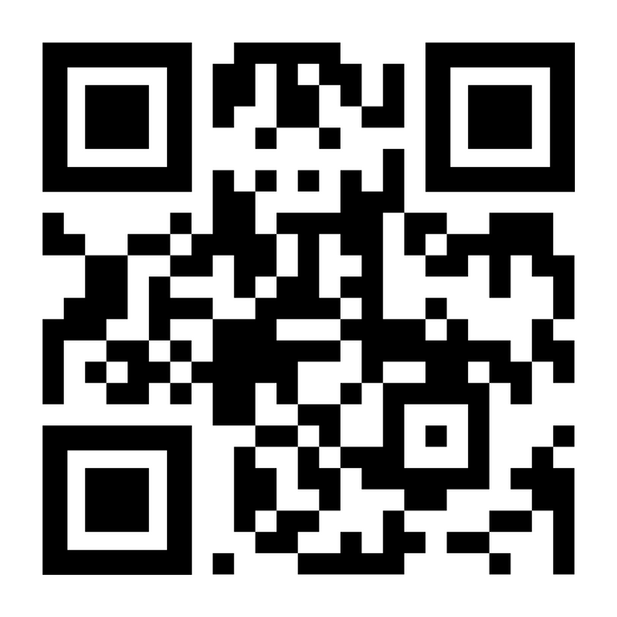
What did you think of this Ideathon?
Funded by the European Union. Views and opinions expressed are however those of the author(s) only and do not Necessarily reflect those of the European Union or the European Education and Culture Executive Agency (EACEA). Neither the European Union nor EACEA can be held responsible for them.

Slide 92




Follow us for updates!
https://www.w4tex-project.eu/
https://www.instagram.com/w4tex_project/
https://www.facebook.com/w4tex/
w4tex.project@gmail.com
Funded by the European Union. Views and opinions expressed are however those of the author(s) only and do not Necessarily reflect those of the European Union or the European Education and Culture Executive Agency (EACEA). Neither the European Union nor EACEA can be held responsible for them.

Slide 93
Thank you for your participation!
Funded by the European Union. Views and opinions expressed are however those of the author(s) only and do not Necessarily reflect those of the European Union or the European Education and Culture Executive Agency (EACEA). Neither the European Union nor EACEA can be held responsible for them.

